Slide 1
Visualization of small molecule docking with transcription factors

Slide 2
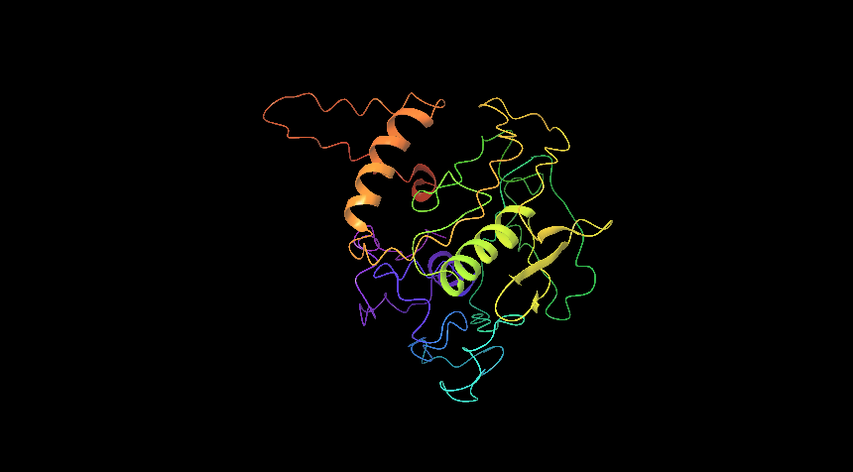
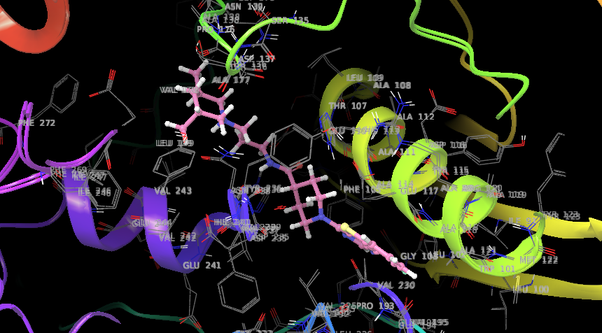
Os01g0165000
Sl no | Entry Name | Formula | Mass | Docking score
1 | ChEBI_111380.1 | C26H34FN5OS | 483.647 | -8.538
2 | ChEBI_93753.1 | C23H30N8O3S | 498.603 | -8.152
3 | ChEBI_116218.1 | C25H28N4O2S2 | 480.649 | -8.111
4 | ChEBI_91563.1 | C17H16N4O2S2 | 372.467 | -7.823
5 | ChEBI_112697.1 | C25H34FN5OS | 471.636 | -7.516
Binding with N-[3-(3,5-dimethyl-1-piperidinyl)propyl]-1-(9-fluoro-[1]benzothiolo[3,2-d]pyrimidin-4-yl)-4-piperidinecarboxamide (ChEBI 111380)
Dehydration-responsive element-binding protein 2A (OS01g0165000)

Slide 3
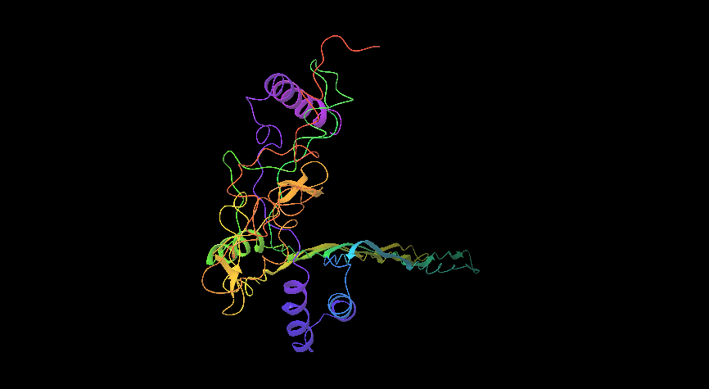
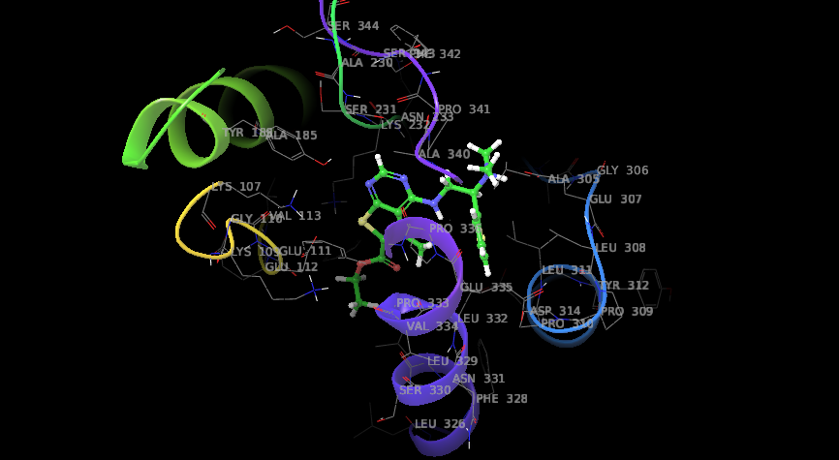
Os01g0224100
Sl no | Entry Name | Formula | Mass | Docking score
1 | ChEBI_109841.1 | C18H22N4O2S2 | 483.647 | -8.538
2 | ChEBI_2790.1 | C21H41N5O11 | 498.603 | -8.152
3 | ChEBI_117196.1 | C22H19N3O5S2 | 480.649 | -8.111
4 | ChEBI_105956.1 | C21H19N5OS2 | 372.467 | -7.823
5 | ChEBI_93430.1 | C17H14FN3OS | 471.636 | -7.516
Binding with 4-[[2-(dimethylamino)-2-thiophen-2-ylethyl]amino]-5-methyl-6-thieno[2,3-d]pyrimidinecarboxylic acid ethyl ester (ChEBI 109841)
AP2 domain containing protein (os01g0224100)

Slide 4
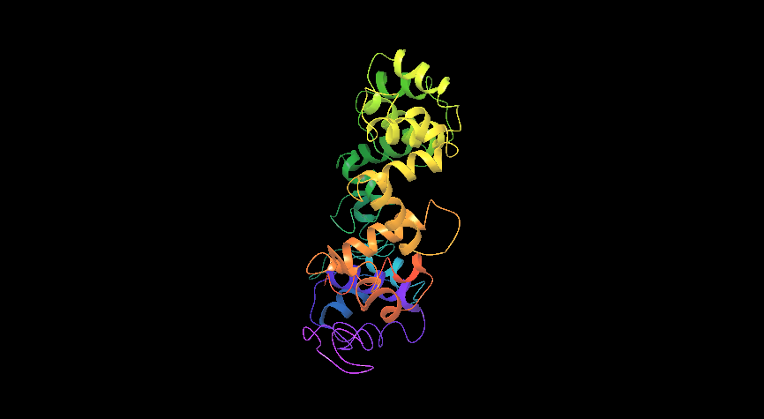
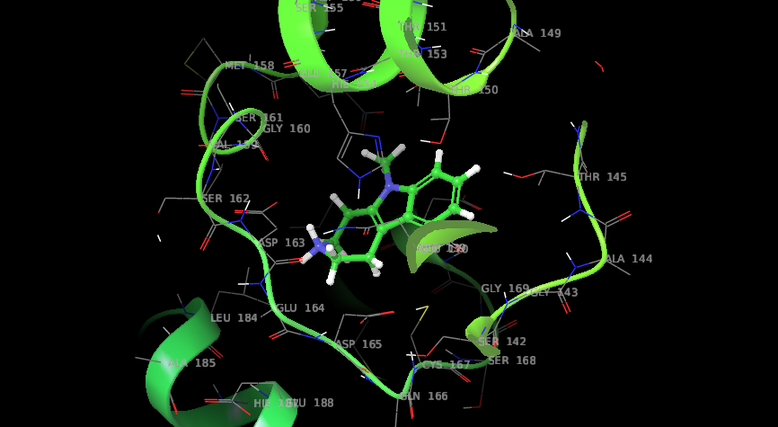
Os01g0302500
Sl no | Entry Name | Formula | Mass | Docking score
1 | ChEBI_92297.1 | C13H16N2 | 200.28 | -5.553
2 | ChEBI_7496.1 | C32H45N3O4S | 567.782 | -5.247
3 | ChEBI_132304.1 | C9H14N2O3S | 230.285 | -5.057
4 | ChEBI_64950.1 | C7H13N | 111.185 | -5.054
5 | ChEBI_132289.1 | C11H18N2O3S | 258.339 | -4.842
Homeobox domain containing protein(Os01g0302500)
Binding with 6-methyl-2,3,4,5-tetrahydro-1H-azepino[4,5-b]indole (ChEBI 92297)

Slide 5
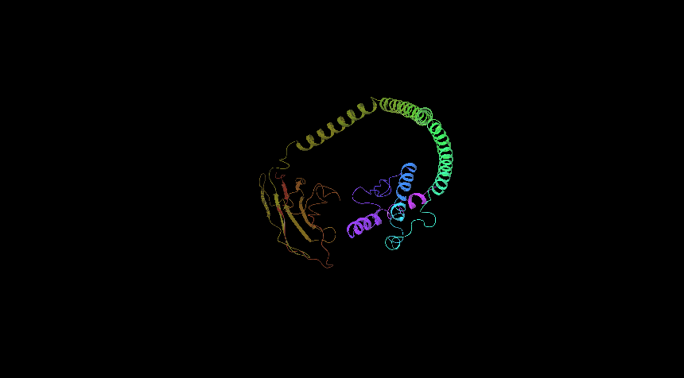
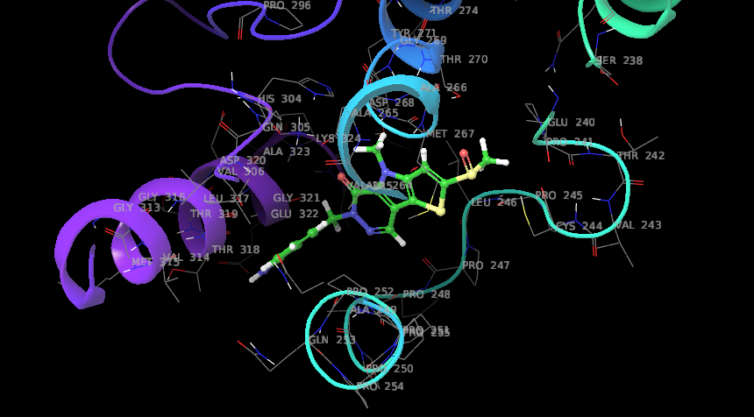
Os01g0625300
Sl no | Entry Name | Formula | Mass | Docking score
1 | ChEBI_91563.1 | C17H16N4O2S2 | 372.467 | -7.366
2 | ChEBI_121813.1 | C19H22ClN3O4S2 | 455.982 | -7.122
3 | ChEBI_2790.1 | C21H41N5O11 | 539.577 | -7.074
4 | ChEBI_109068.1 | C18H15N3OS2 | 353.464 | -6.949
5 | ChEBI_116184.1 | C17H13N5O4 | 351.317 | -6.896
Binding with 6-[(3-aminophenyl)methyl]-4-methyl-2-methylsulfinyl-5-thieno[3,4]pyrrolo[1,3-d]pyridazinone (ChEBI 91563)
HSF-DNA binding protein (os01g0625300)

Slide 6
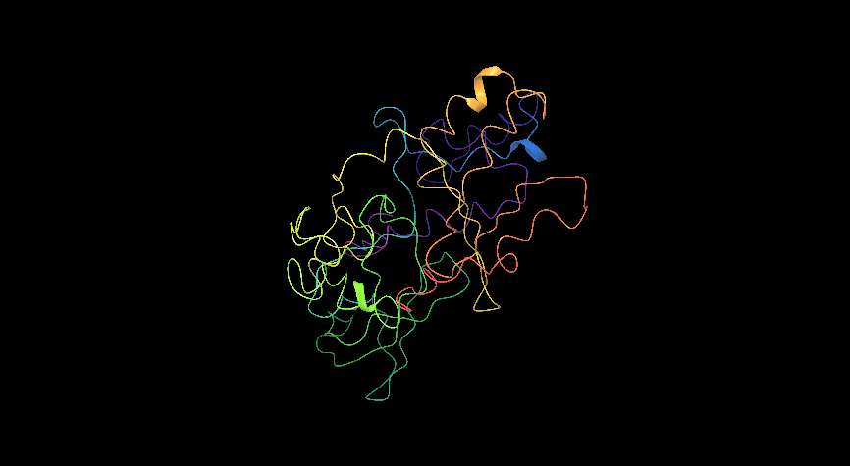
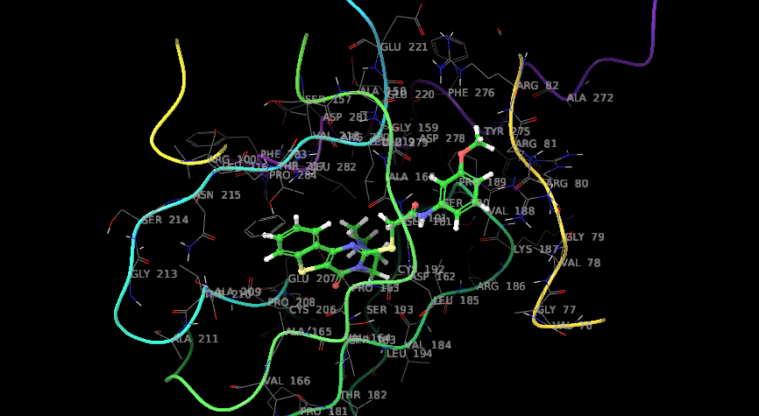
Os01g0657400
Sl no | Entry Name | Formula | Mass | Docking score
1 | ChEBI_104036.1 | C23H24N4O3S2 | 468.595 | -7.264
2 | ChEBI_92297.1 | C13H16N2 | 1094.007 | -6.947
3 | ChEBI_112923.1 | C20H20N4O3S2 | 428.531 | -6.764
4 | ChEBI_2790.1 | C21H41N5O11 | 539.577 | -6.743
5 | ChEBI_91482.1 | C18H16FN3O2S | 357.404 | -6.71
Binding with 2-[[3-[2-(dimethylamino)ethyl]-4-oxo-[1]benzothiolo[3,2-d]pyrimidin-2-yl]thio]-N-(3-methoxyphenyl)acetamide (ChEBI 104036)
Protein containing AP2 domain (Os01g0657400)

Slide 7
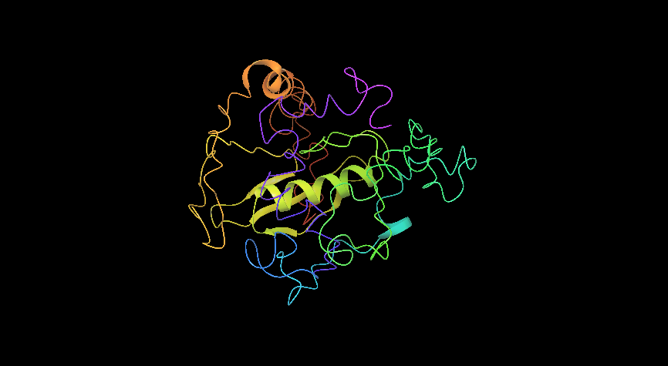
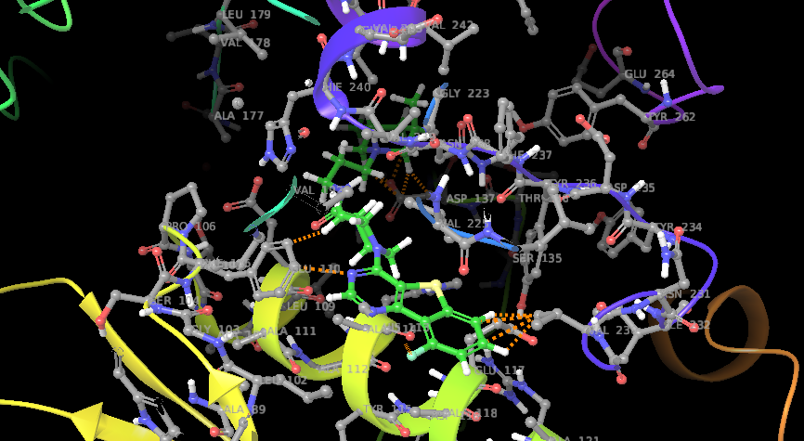
os01g0734000
Sl no | Entry Name | Formula | Mass | Docking score
1 | ChEBI_111380.1 | C26H34FN5OS | 483.647 | -8.419
2 | ChEBI_112697.1 | C25H34FN5OS | 471.636 | -8.401
3 | ChEBI_111380.1 | C26H34FN5OS | 483.647 | -8.219
4 | ChEBI_93753.1 | C23H30N8O3S | 498.603 | -8.089
5 | ChEBI_116218.1 | C25H28N4O2S2 | 480.649 | -8.084
Binding with N-[3-(3,5-dimethyl-1-piperidinyl)propyl]-1-(9-fluoro-[1]benzothiolo[3,2-d]pyrimidin-4-yl)-4-piperidinecarboxamide (ChEBI 111380)
WRKY23 (os01g0734000 )

Slide 8
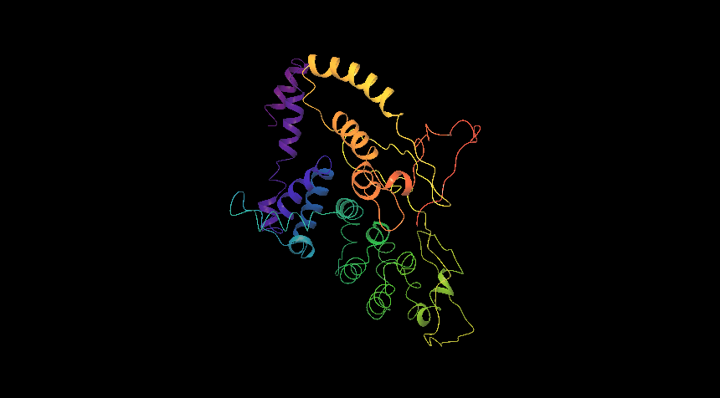
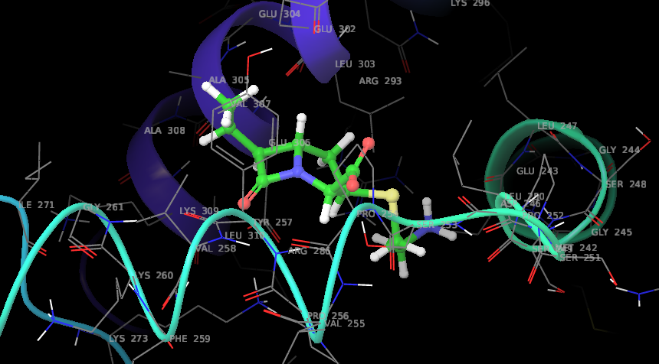
Os02g0766700
Sl no | Entry Name | Formula | Mass | Docking score
1 | ChEBI_132289.1 | C11H18N2O3S | 258.339 | -6.798
2 | ChEBI_132290.1 | C10H16N2O3S | 244.312 | -6.712
3 | ChEBI_132304.1 | C9H14N2O3S | 230.285 | -6.373
4 | ChEBI_77692.1 | C27H48O11 | 548.663 | -6.062
5 | ChEBI_91482.1 | C18H16FN3O2S | 357.404 | -5.998
Binding with 3-[(2-aminoethyl)sulfanyl]-6-ethyl-7-oxo-1-azabicyclo[3.2.0]heptane-2-carboxylic acid (ChEBI 132289)
bZIP transcription factor 23 (Os02g0766700)

Slide 9
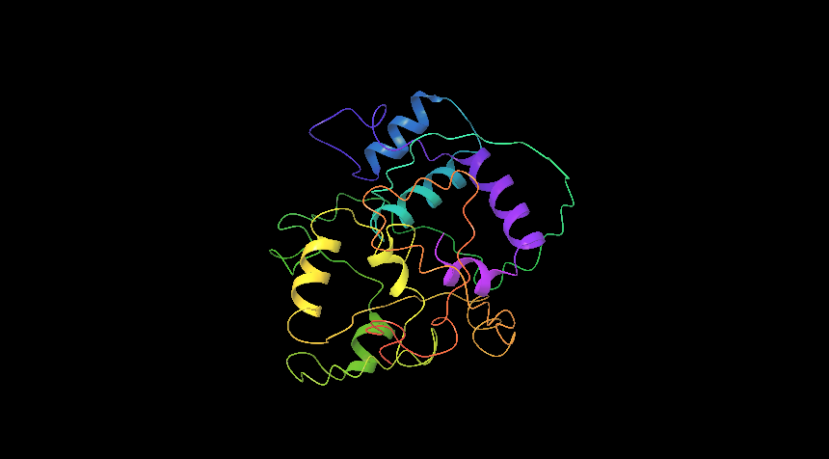
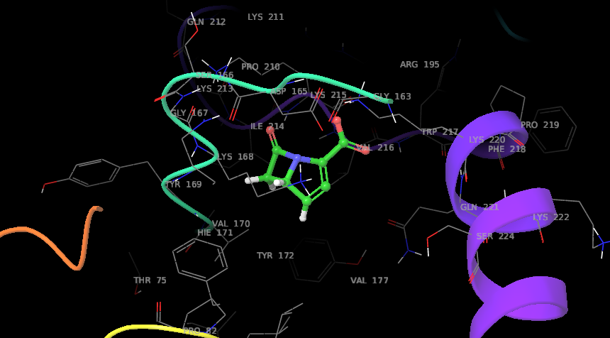
os03g0769800
Sl no | Entry Name | Formula | Mass | Docking score
1 | ChEBI_46633.1 | C7H4NO3R3 | 150.019 | -7.309
2 | ChEBI_65562.1 | C27H36O3 | 408.573 | -6.983
3 | ChEBI_49081 | C14H14N2O8 | 338.27 | -6.981
4 | ChEBI_167099 | C7H5NOS | 151.186 | -6.968
5 | ChEBI_49081 | C14H14N2O8 | 338.27 | -6.728
Homeobox domain containing protein (os03g0769800 )
Binding with carbapenems (ChEBI 46633)

Slide 10
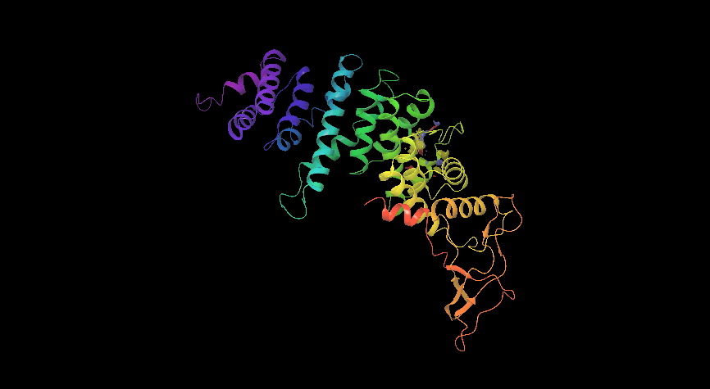
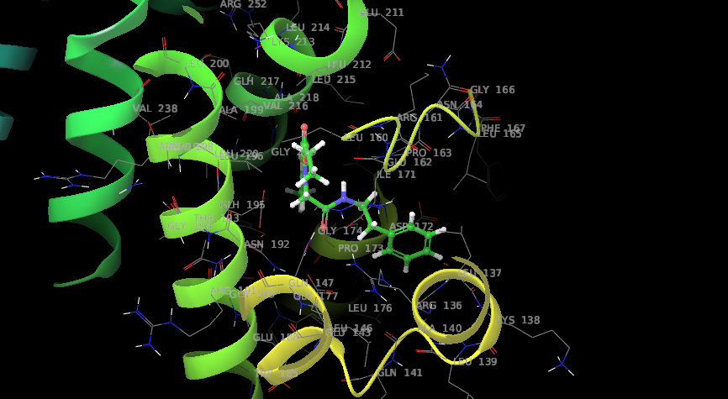
Os04g0637000
Sl no | Entry Name | Formula | Mass | Docking score
1 | ChEBI_120790.1 | C20H22N2O3S | 370.467 | -6.826
2 | ChEBI_74113.1 | C15H20O4 | 264.317 | -6.821
3 | ChEBI_40279.1 | C5H4N4O | 136.112 | -6.727
4 | ChEBI_91482.1 | C18H16FN3O2S | 357.404 | -6.726
5 | ChEBI_132289.1 | C11H18N2O3S | 258.339 | -6.659
Binding with 2-methyl-4-[2-oxo-2-(2-phenylethylamino)ethyl]-5-thieno[3,2-b]pyrrolecarboxylic acid ethyl ester (ChEBI 120790)
Transcription factor TGAL6 (Os04g0637000 )

Slide 11
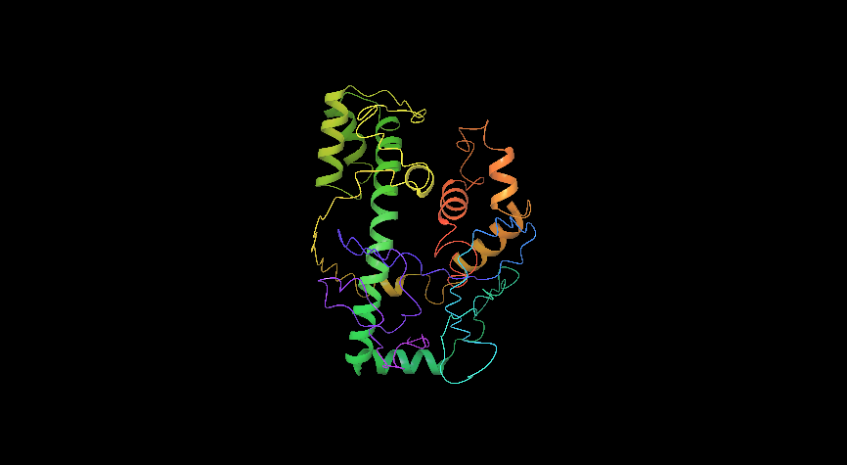
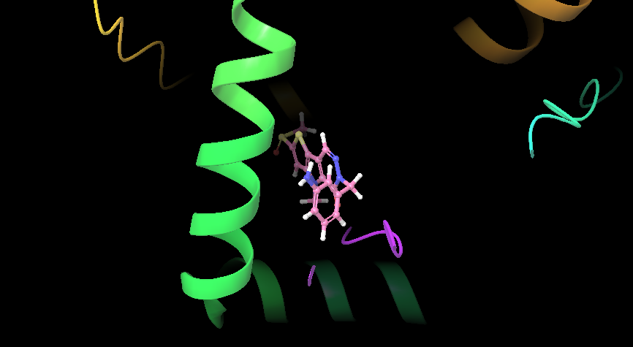
Os06g0140700
Sl no | Entry Name | Formula | Mass | Docking score
1 | ChEBI_91563.1 | C17H16N4O2S2 | 372.467 | -7.462
2 | ChEBI_93753.1 | C23H30N8O3S | 498.603 | -7.394
3 | ChEBI_105867.1 | C18H19N3O4S | 373.428 | -7.306
4 | ChEBI_91534.1 | C18H17N3O3S2 | 387.479 | -7.267
5 | ChEBI_91482.1 | C18H16FN3O2S | 357.404 | -7.17
Binding with 6-[(3-aminophenyl)methyl]-4-methyl-2-methylsulfinyl-5-thieno[3,4]pyrrolo[1,3-d]pyridazinone (ChEBI 91563)
Homeobox leucine zipper protein (Os06g0140700)

Slide 12
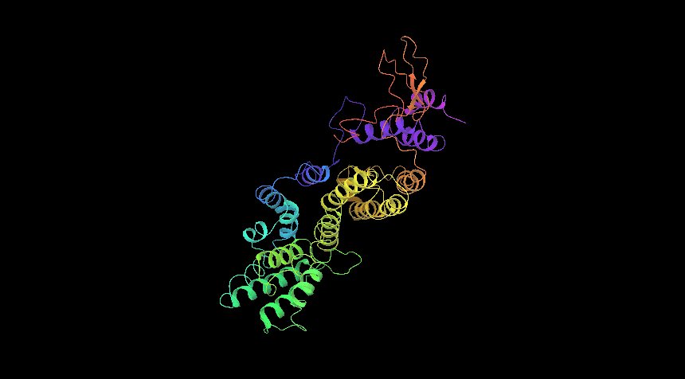
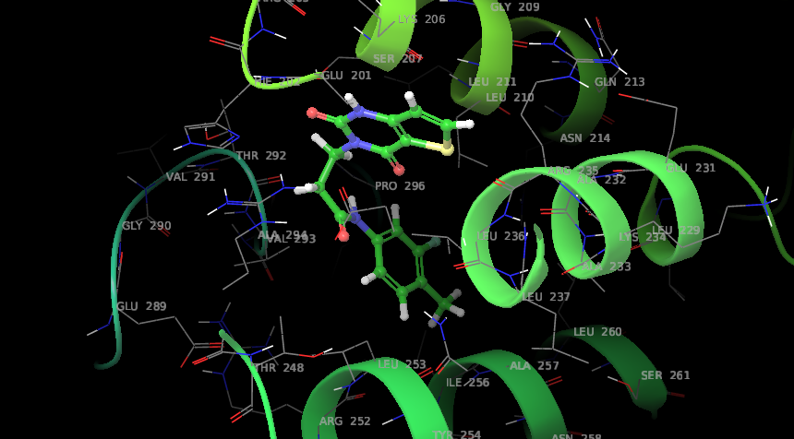
Os06g0245900
Sl no | Entry Name | Formula | Mass | Docking score
1 | ChEBI_116830.1 | C16H14FN3O3S | 347.366 | -8.111
2 | ChEBI_66599.1 | C19H20O7 | 360.358 | -7.945
3 | ChEBI_93841.1 | C23H21N3O2S2 | 435.565 | -7.185
4 | ChEBI_68284.1 | C14H14O6 | 278.257 | -7.101
5 | ChEBI_105258.1 | C19H17N5OS2 | 395.504 | -7.067
EF2 family transcription factor protein(Os06g0245900)
Binding with 3-(2,4-dioxo-1H-thieno[3,2-d]pyrimidin-3-yl)-N-(3-fluoro-4-methylphenyl)propanamide (ChEBI 116830)

Slide 13
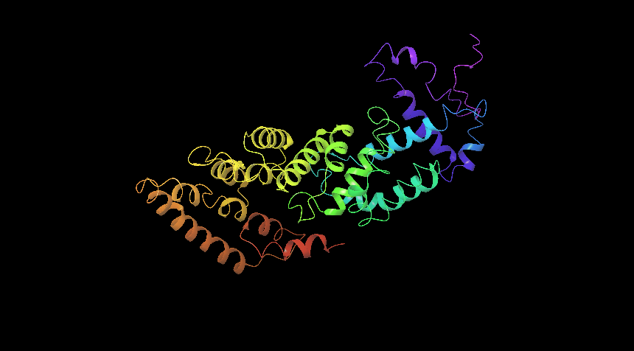
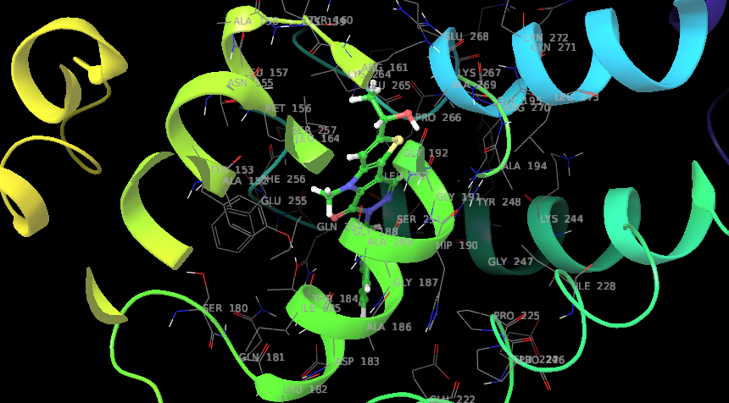
Os07g0129700
Sl no | Entry Name | Formula | Mass | Docking score
1 | ChEBI_91482.1 | C18H16FN3O2S | 357.404 | -7.578
2 | ChEBI_107247.1 | C14H12N2O2S | 272.324 | -7.296
3 | ChEBI_91563.1 | C17H16N4O2S2 | 372.467 | -6.955
4 | ChEBI_92959.1 | C16H13N3OS | 295.361 | -6.857
5 | ChEBI_123206.1 | C12H12N4S | 244.317 | -6.814
Homeobox domain containing domain (Os07g0129700)
Binding with 6-[(2-fluorophenyl)methyl]-2-(1-hydroxyethyl)-4-methyl-5-thieno[3,4]pyrrolo[1,3-d]pyridazinone (ChEBI 91482)

Slide 14
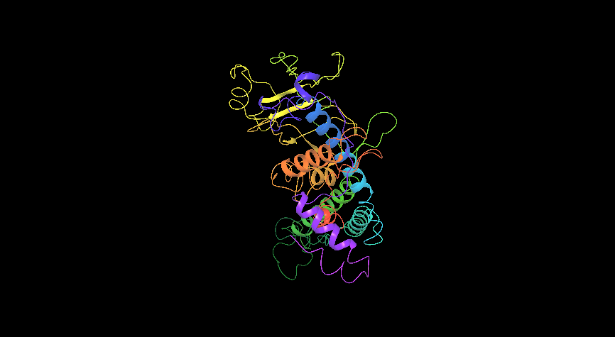
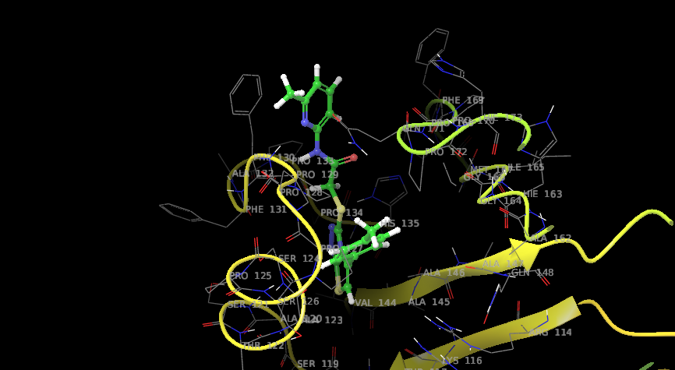
Os09g0455200
Sl no | Entry Name | Formula | Mass | Docking score
1 | ChEBI_112366.1 | C18H19N3O2S2 | 373.495 | -7.82
2 | ChEBI_104036.1 | C23H24N4O3S2 | 468.595 | -7.613
3 | ChEBI_116184.1 | C17H13N5O4 | 351.317 | -7.59
4 | ChEBI_115053.1 | C17H15N3O4S | 357.385 | -7.547
5 | ChEBI_49081.1 | C14H14N2O8 | 338.2696 | -7.536
HSF-DNA containing domain (Os09g0455200)
Binding 2-[[5-(4-methylphenyl)-3-thiazolo[2,3-c][1,2,4]triazolyl]thio]-N-(6-methyl-2-pyridinyl)acetamide (ChEBI 112366)

Slide 15
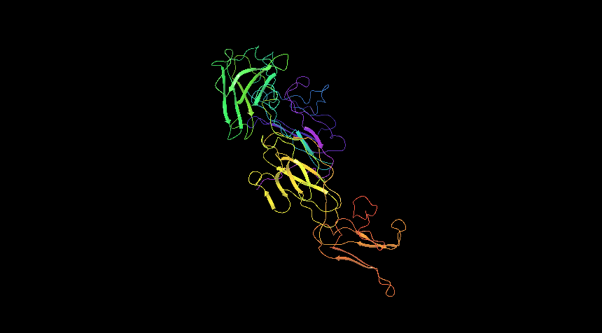
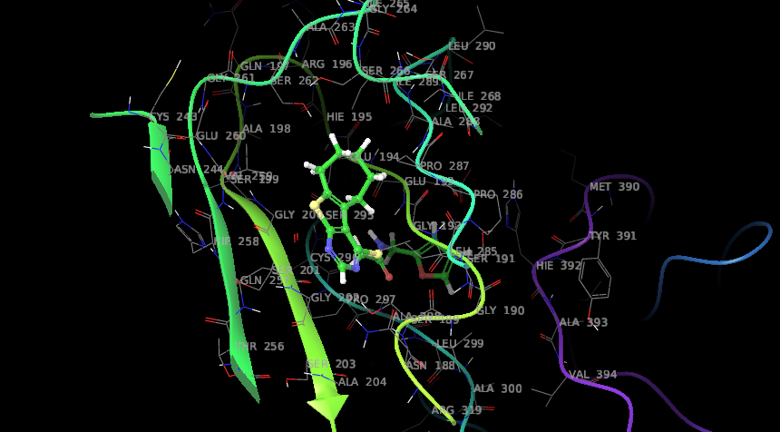
Os09g0526600
Sl no | Entry Name | Formula | Mass | Docking score
1 | ChEBI_112366.1 | C18H19N3O2S2 | 373.495 | -7.82
2 | ChEBI_104036.1 | C23H24N4O3S2 | 468.595 | -7.613
3 | ChEBI_116184.1 | C17H13N5O4 | 351.317 | -7.59
4 | ChEBI_115053.1 | C17H15N3O4S | 357.385 | -7.547
5 | ChEBI_49081.1 | C14H14N2O8 | 338.2696 | -7.536
HSF-DNA containing domain (Os09g0526600)
Binding N-(2-furanylmethyl)-2-(6,7,8,9-tetrahydro-5H-cyclohepta[2,3]thieno[2,4-d]pyrimidin-4-ylthio)acetamide (ChEBI 112366)

Slide 16
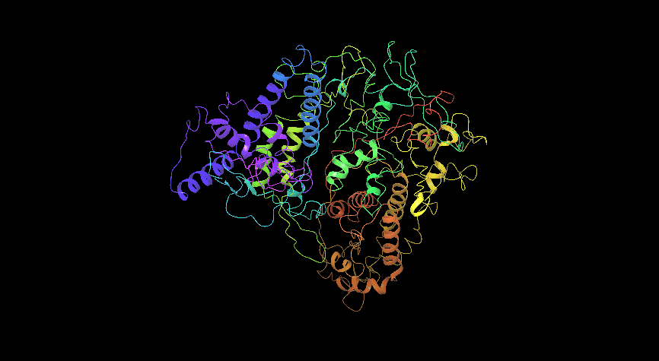
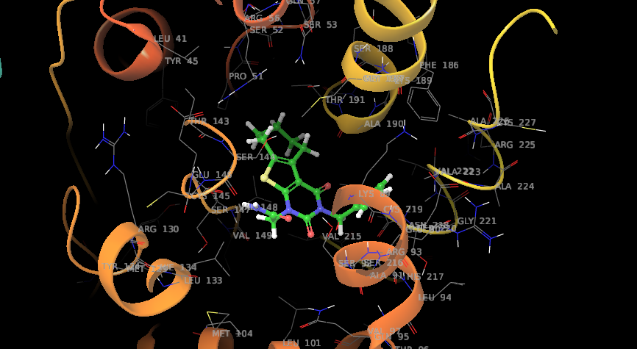
Os12g0612700
Sl no | Entry Name | Formula | Mass | Docking score
1 | ChEBI_105867.1 | C18H19N3O4S | 373.428 | -7.823
2 | ChEBI_116218.1 | C25H28N4O2S2 | 480.649 | -7.418
3 | ChEBI_114841.1 | C21H19N3O3S2 | 425.527 | -7.351
4 | ChEBI_68284.1 | C14H14O6 | 278.257 | -7.326
5 | ChEBI_109406.1 | C24H26N4O3S2 | 482.621 | -7.314
HSF-DNA containing domain (Os12g0612700)
Binding 2-[3-(2-furanylmethyl)-2,4-dioxo-6,7,8,9-tetrahydro-5H-cyclohepta[2,3]thieno[2,4-b]pyrimidin-1-yl]acetamide (ChEBI 105867)

